Slide 1






PROJECT
PRESENTATION
by Group 4

Slide 2
Our Team
Manar Ashraf Eissa
Abdelrhman mohamed hussien
Fatma Khider Hussein
Eman Salah Hassan
Abdelrahman Salah Abdelkareem
Yassin ahmed elhabak

Slide 3

Background
Supply chain analytics has become a critical area in modern business operations, as organizations increasingly rely on data to improve efficiency and reduce costs. It involves analyzing data generated from various supply chain activities such as procurement, inventory management, transportation, and customer demand.
Previous studies have shown that effective data analysis can help organizations identify inefficiencies, reduce delivery delays, and optimize inventory levels. By leveraging analytical tools, companies can make informed decisions that enhance overall performance and customer satisfaction.
Additionally, the use of visualization tools such as dashboards has proven to be highly effective in presenting insights in a clear and actionable way. These tools enable decision-makers to monitor KPIs and respond quickly to changes in supply chain operations.

Slide 4
Objectives
Analyze supply chain data in order to identify patterns, trends, and key factors affecting sales, inventory, and delivery performance.
Evaluate operational efficiency by detecting issues such as delays in shipments, stock shortages, and overstock situations.
Develop interactive dashboards and visualizations using tools like Power BI and Tableau to support data-driven decision-making.

Slide 5
Process
Data collection
Data cleaning and transforming
Setting Business questions and analyzing
Visualizing
Recommendations and reporting

Slide 6
1- collecting data
we collected raw supply chain data from ”Oracle”

Slide 7
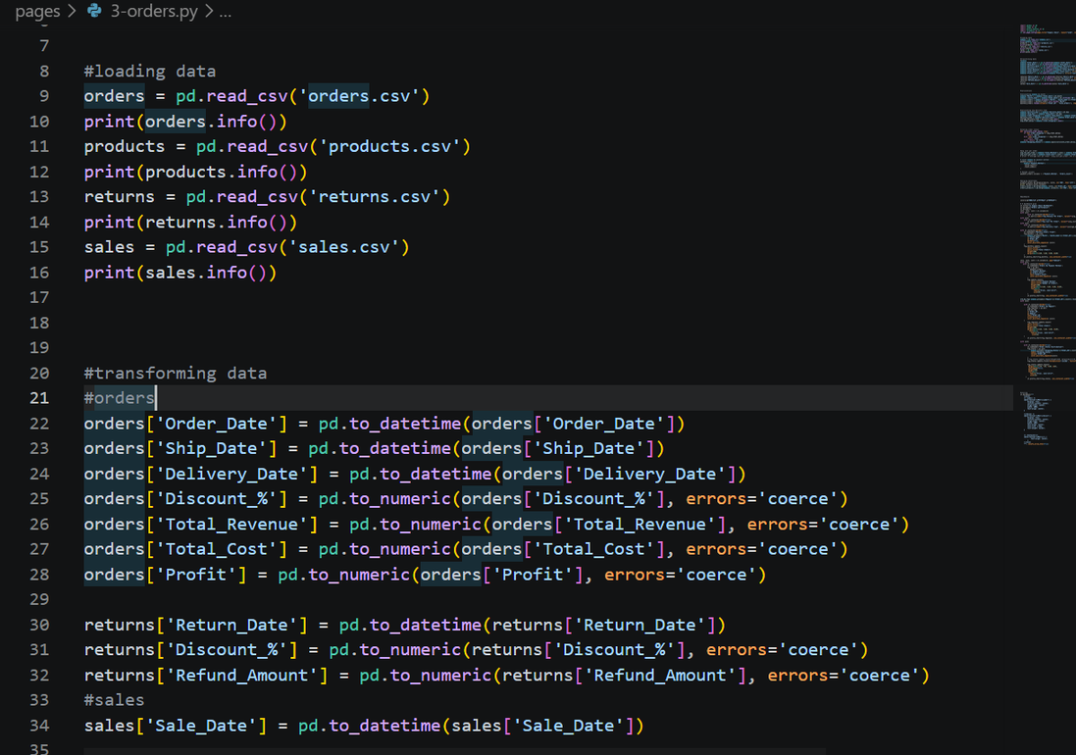
2- data cleaning
read and cleaned data using python
fixed and changed inappropriate data types
rounded values

Slide 8
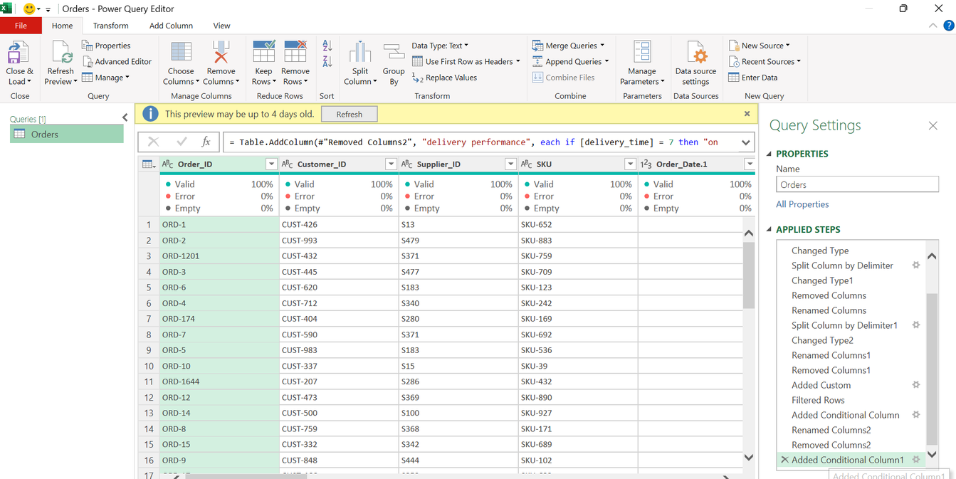
2- data cleaning
loaded data to excel power query
removed unwanted columns
created conditional columns to count delivery performance
created custom column to indicate order status in numbers

Slide 9
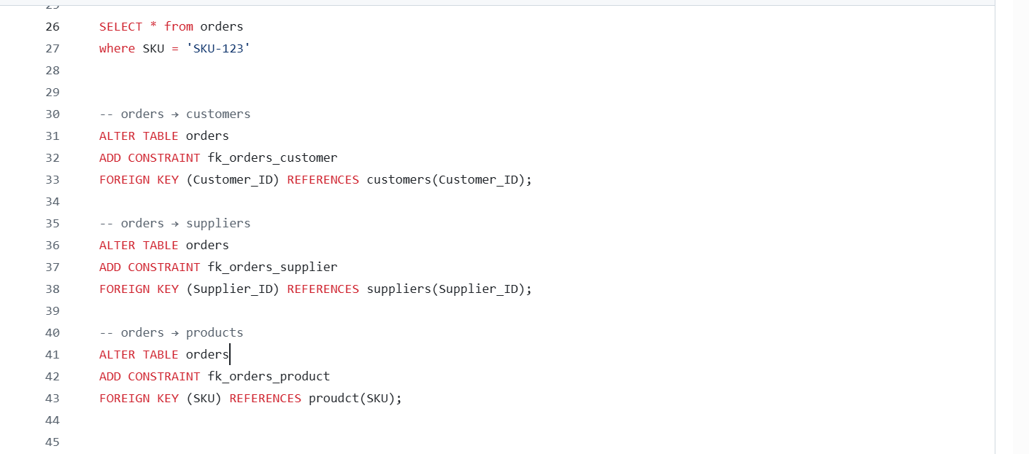
2- data cleaning
retrieved data using SQL
modeled data and added constraints
answered basic questions

Slide 10
3- defining questions
how sales was affected monthly?
which region shares with most sales?
what are the most and least profitable product
how does the Discount impact total sales volume and overall profitability
what is the actual revenue from sold orders and the gap between it and total revenue from all orders?
what is the most preferred payment method and how that affects revenue?
what is delivery performance?
how many orders were late delivered?
what products are mostly late to be delivered?
which region is mostly late to deliver?

Slide 11
3- defining questions
what is the stock distribution across products categories?
what is the most common reason for product returns and what is its financial impact?
how many ordders are there each month?
what are the returned products across categories and what are their counts?
who are our main suppliers? (region)
which suppliers are associated with the highest number of products returns?

Slide 12
Main KPIs
Total revenue (per order)
Net revenue (only sold orders)
Total orders
Total sold orders
Avg revenue by order
Avg cost by order
Total profit
Profit margin
Delayed orders
Avg delivery time
Delayed region
Returned products
Refund amount
Return rate
Stock distribution

Slide 13
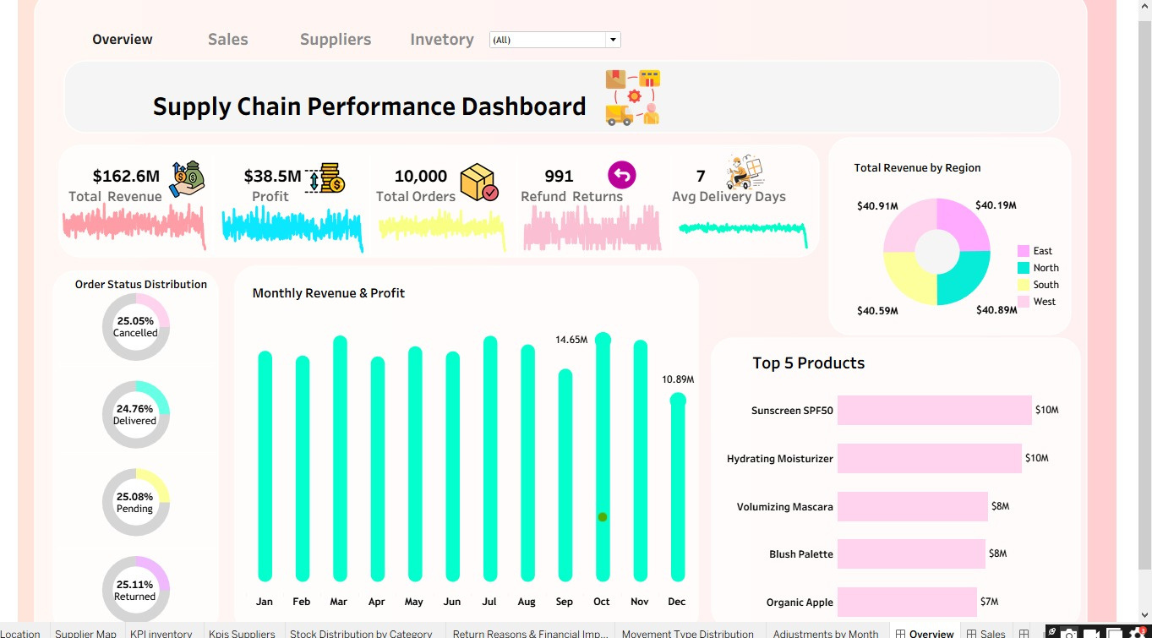
Tableau dashboard

Slide 14
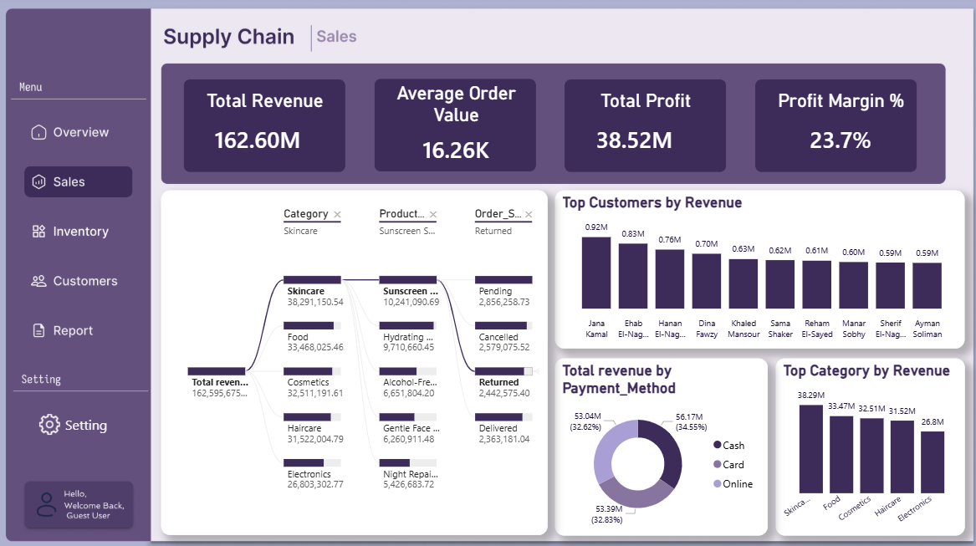
Power BI dashboard

Slide 15
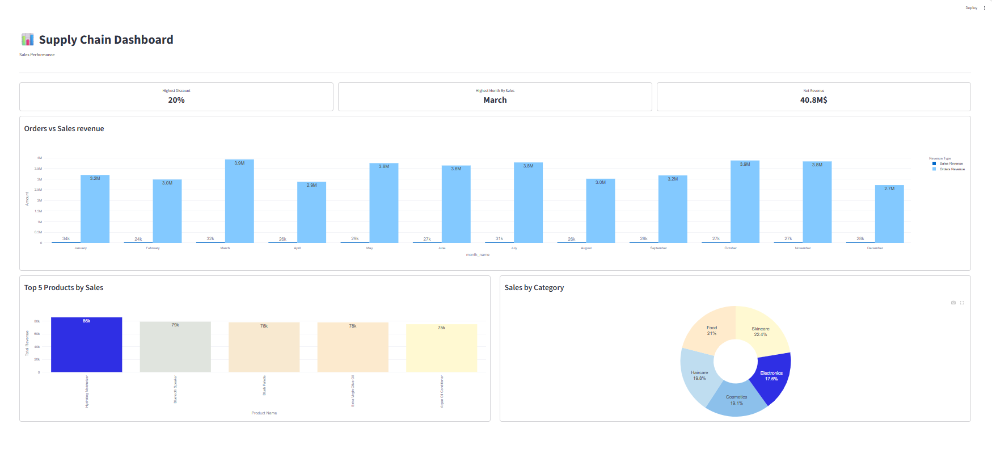
Python dashboard

Slide 16
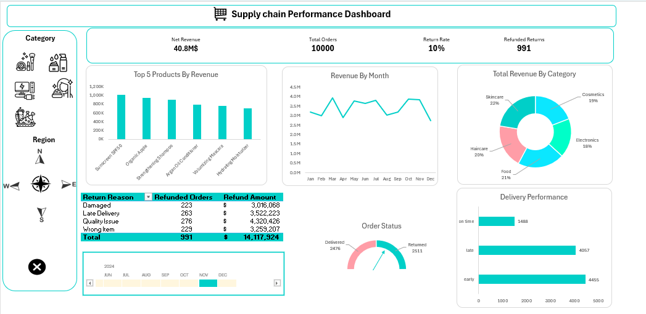
Excel dashboard

Slide 17
5- Analysis & Reporting
Exacutive summary
‘West’ has the highest numbers of orders, however, it is the most delayed region
Return rate is close to 10% which means approximately 1000 orders were returned
highly ordered product is “sunscreen”, while “Hydrating moisturizer” shared highest revenue (sold and not returned)
Total revenue by order is about 162M, while orders that already sold make about 40.8M, indicating a significant gap.
Most products were returned because they were damaged

Slide 18
5- Analysis & Reporting
Sales Performance
Increasing discount rates negatively impacted profitability, while revenue growth remained relatively limited.
Highest-demand category is skincare, indicating strong customer interest in personal care products.
Cost per order is higher than revenue per order, which says that we’re losing.
company maintains a high overall inventory level, however, some products remain understocked or unavailable.

Slide 19
5- Analysis & Reporting
Return analysis
high demanding products showed the highest delay frequency due to stock.
Avg delivery time is close to 7 days, referring to long time, causing cancelation and return causes.

Slide 20
6- Recommendations
Optimize delivery operations in the West region to reduce delays and improve customer satisfaction.
Reduce product damage through better packaging and stricter quality control processes.
Reevaluate discount strategies to protect profit margins while maintaining sales performance.
Improve inventory allocation and demand forecasting to avoid stock shortages and overstocking.
Reduce average delivery time by optimizing shipping and fulfillment operations or change shipping companies.

Slide 21
6- Recommendations
Focus marketing and stock availability on high-revenue products such as Hydrating Moisturizer and Sunscreen.
Reduce operational and fulfillment costs to improve overall profitability.
Monitor supplier performance and investigate suppliers linked to high return rates.
Analyze return patterns regularly to lower the return rate and refund losses.
Maintain sufficient stock levels for high-demand products to prevent delays and lost sales.

Slide 22
Any Question ?

Slide 23
THANK YOU

